Slide 1
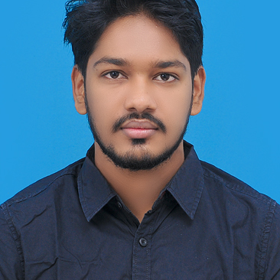


Sourav Kumar Kuila
Analyst/Software Engineer
Bachelor of Technology (2018-2022)
Biotechnology
Skills
Mumbai
SOURAV.KUILA@CAPGEMINI.COM
Java 8 /J2EE | Java Basics, OOPS, Generics, Collections, Arrays, Loops, Lambda Exp, Stream API Junit.
Agile software development | Frameworks ,Scrum ,Sprint, XP.
Spring core | IOC & Dependency Injection, Autowire
Spring REST | REST controllers, Implementation of GET, POST, PUT & DELETE, Bean Validation & Exception Handling, Testing Services, Controller & Repository layer
Spring Boot Microservices | Spring Boot Starters, annotations, Messaging Service, Sync/Async comms, Swagger API specifications
Spring Cloud | Eureka , Hystrix, Config Server
Database | MongoDB
UI Tech | HTML 5 & CSS 3,JavaScript, ES6 & TypeScript
Tools | Git, Postman, Maven, Eclipse IDE, Visual Studio.
Add On skills | Leadership, Team management.
+91 8825113878
A4
Full Stack Developer
● Hands on experience in creating microservices with Spring boot, Spring Security, Spring Cloud API Gateway, Eureka server.
● Hands on experience in creating single page web application using Angular with Authentication with route guards, Angular reactive forms, angular routing, CSS, HTML ,Angular Material.
● Java Microservice Development knowledge using Spring boot and spring cloud framework on an intermediate level.
Online Hotel Management System
Completed end to end Hotel management system. Application using Java Full Stack with angular. along with JWT authentication
Implemented Multiple Microservices using Spring Boot and Spring Cloud and connecting them via a Discovery Server i.e. Eureka. Including routing using Netflix ZULL as a API Gateway and used SWAGGER Documentation.
• Frontend with Angular 12, using Angular CLI for creating a user-friendly UI. • Backend with MongoDB Compass.
• Completed the Capgemini ADAPT Java Full Stack Angular training.
Check out my work on GitHub

